Slide 1

Research:
Capability Of
TIBCO Platform
By: Tan Wei Jun, Terris
FYPJ 2019 Semester 1 Period 2

Slide 2





Background
NYP have an MOU with TIBCO
To setup a centre with exhibits leveraging on TIBCO platform

Slide 3
Objective
Research TIBCO platform
Create demos
Document a usage guide
Make a final conclusion on TIBCO

Slide 4







Project Overview
Explore TIBCO Spotfire
Create Demo Applications
Connect Spotfire with Demo App

Slide 5
Project Overview
Explore TIBCO Spotfire
Create Demo Applications
Connect Spotfire with Demo App

Slide 6
Project Overview
Explore TIBCO Spotfire
Create Demo Applications
Connect Spotfire with Demo App

Slide 7
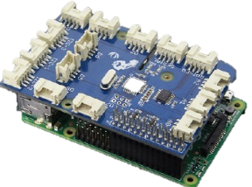
Project Overview
Explore TIBCO Spotfire
Create Demo Applications
Connect Spotfire with Demo App
Introduce IoT technology

Slide 8
Project Overview
Explore TIBCO Spotfire
Create Demo Applications
Connect Spotfire with Demo App
Introduce IoT technology

Slide 9
Project Overview
Explore TIBCO Spotfire
Create Demo Applications
Connect Spotfire with Demo App
Introduce IoT technology

Slide 10
Project Overview
Explore TIBCO Spotfire
Create Demo Applications
Connect Spotfire with Demo App
Introduce IoT technology

Slide 11




Overall Achievements
Using TIBCO Spotfire
Created 3 Analysis
Made Visualisations
Created 3 Demo Applications
Database To Excel App
Spotfire Demo App
IoT Spotfire Demo App

Slide 12
















Tasks Per Week
Week 1
TIBCO Accelerators
TIBCO Spotfire Web Client

Slide 13






Tasks Per Week
Week 2
Visualisations
Using databases from
Development on Database To Excel App

Slide 14


Tasks Per Week
Week 3
Completed my first App
Converted OH 2019 Database
Created OH 2019 Visualisations
Discovered Spotfire Desktop App

Slide 15




Tasks Per Week
Week 4
Development on SpotfireDemo App
Connect:
SpotfireDemo App to Spotfire App

Slide 16
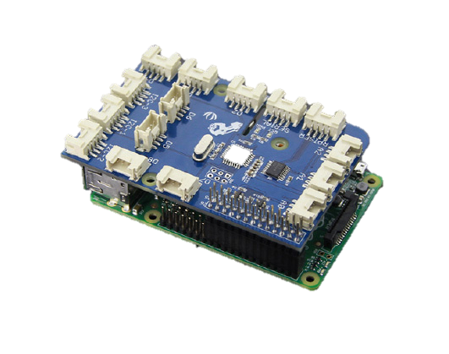






Tasks Per Week
Week 5
Development on IoT Background App
Connect:
IoT App to SpotfireDemo App to Spotfire App

Slide 17


Tasks Per Week
Week 6
Finalize my work
Presentation

Slide 18
Demo

Slide 19

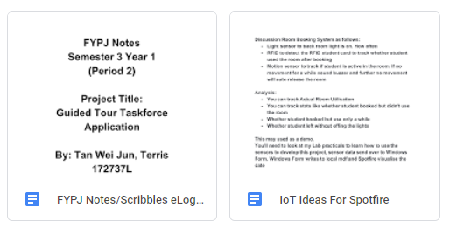
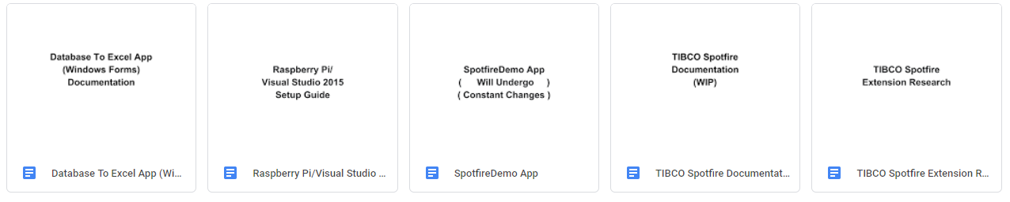
Q&A – Usage Guide/Documentations

Slide 20
Q&A – Difficulties/Challenges
Explore unknown territories
Limited online solutions
Re-configure to VS 2015 Updates 3
Create complex algorithms
Learn IoT

Slide 21
Q&A – Next For Final Presentation
Explore more into TIBCO
Create more demo scenarios
Give a final conclusion on TIBCO

Slide 22
End

